Slide 1

http://140.116.245.148/WebCourse/students/e24035097/hw1/index.html

Slide 2
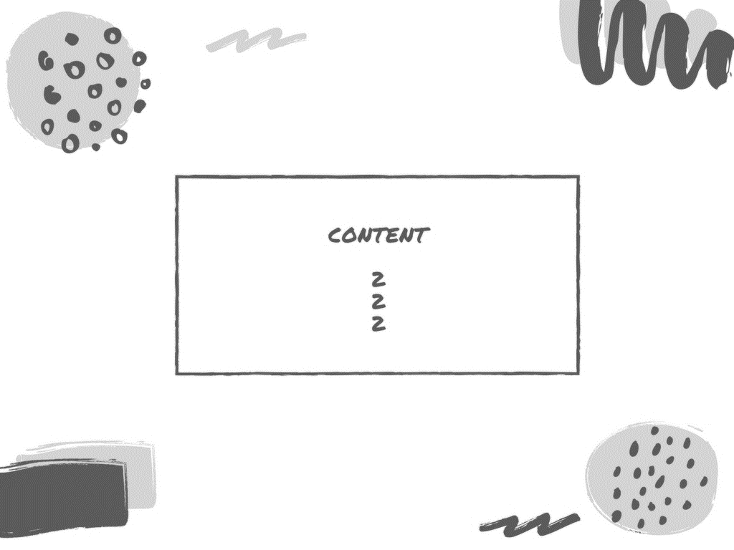
3-9 Web Page Overview
10-16 Web Page Introduction
17-18 常用語法舉例
19-20 Difficulty & Solution

Slide 3
W E B P A G E O V E R V I E W

Slide 4
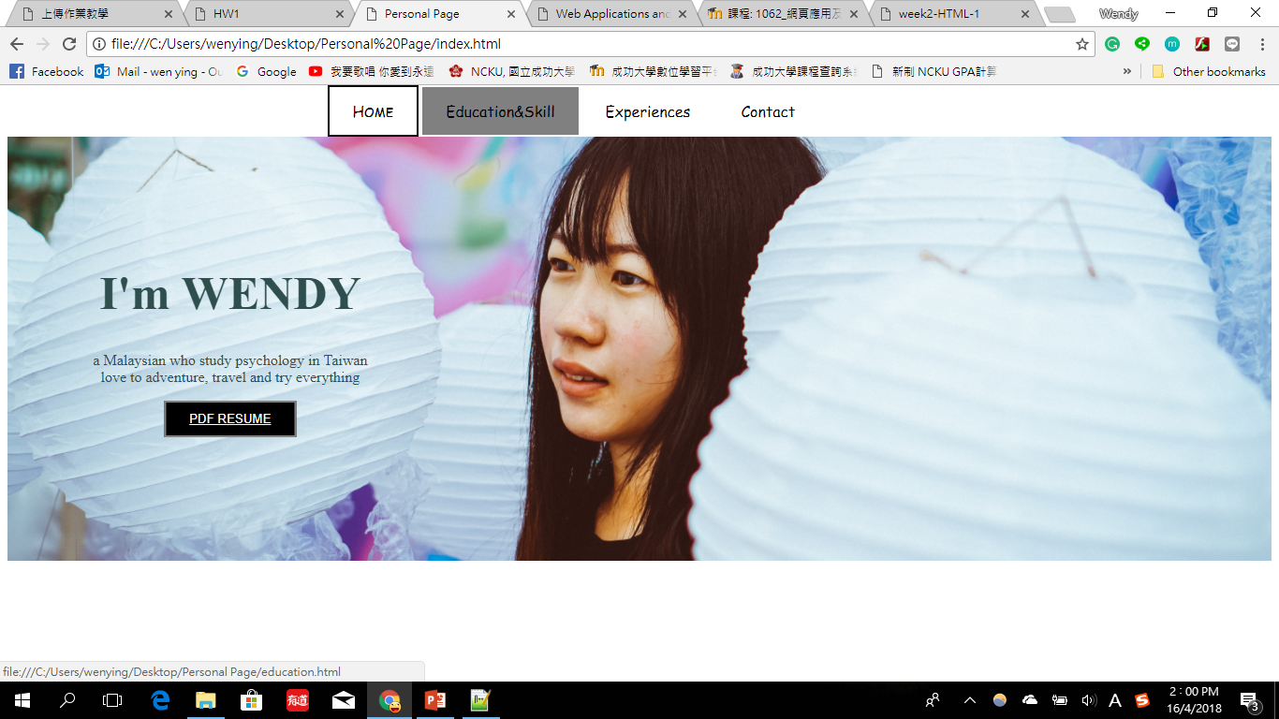
I
N
D
E
X
http://140.116.245.148/WebCourse/students/e24035097/hw1/index.html

Slide 5
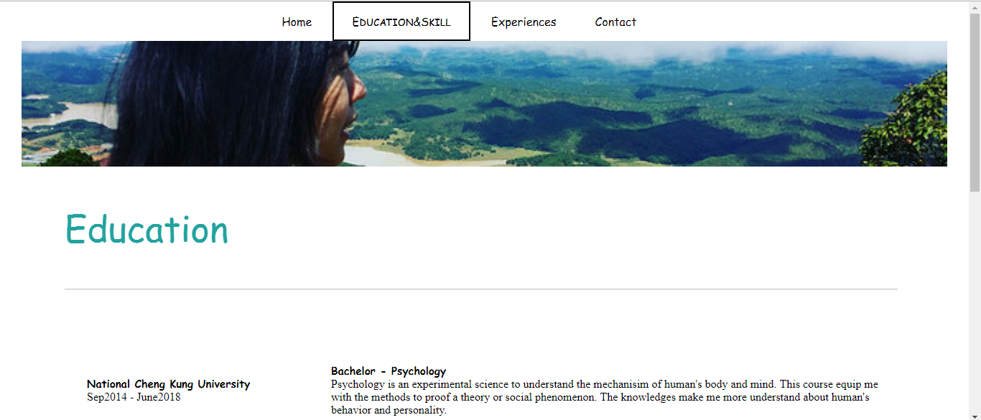
SECOND PAGE:
Education&Skill

Slide 6
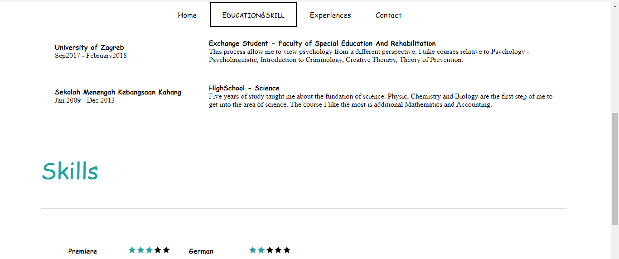
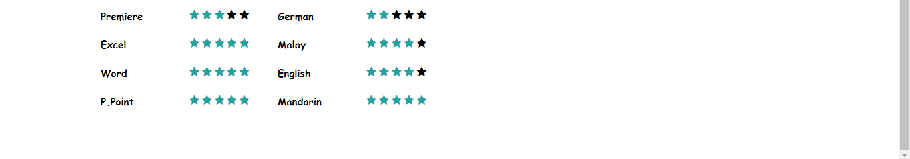

Slide 7
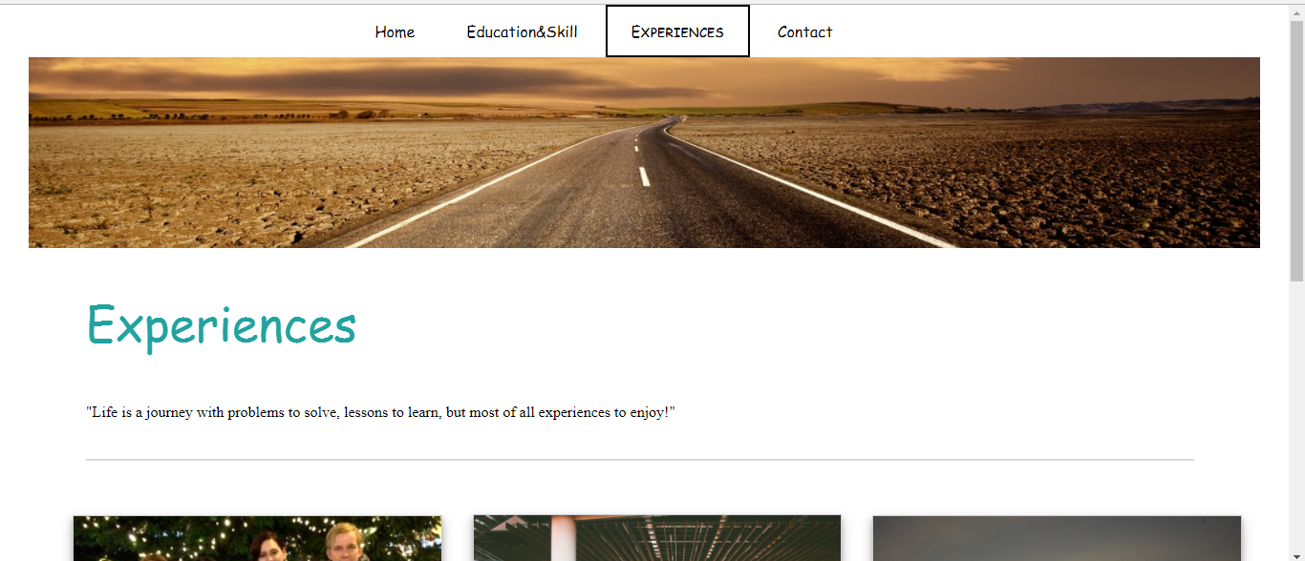
THIRD PAGE:
Experiences

Slide 8
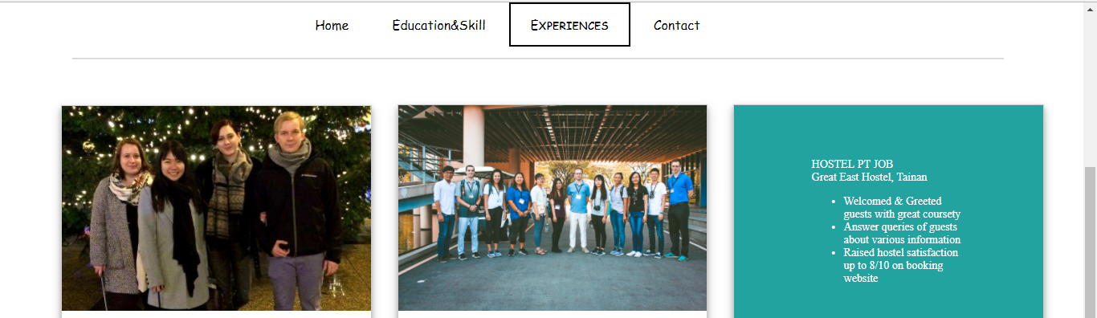
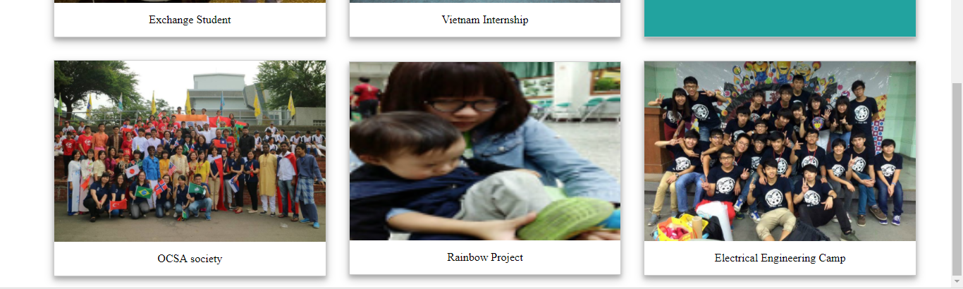

Slide 9
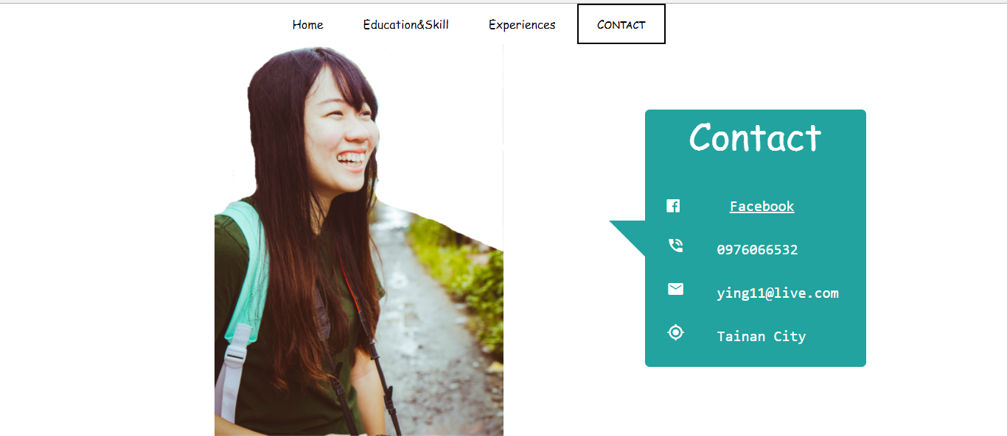
Forth PAGE:
Contact

Slide 10
W E B P A G E I N T R O D U C T I O N

Slide 11
I
N
D
E
X
NAVIGATION BAR
-fixed on top
-hover[change background-color]
-active[add border, CAP font]
-CSS used: overflow, background-color, position, padding, width, text-align, text-decoration, font-family, font-variant, z-index, border
-HTML used: <a>hyperlink tag
TEXT
-use template of Animation.CSS –animation name: Jello [transform for 8 s]
-CSS used: text-align, position, top, left, transform, animation-name, duration, keyframes
BACKGROUND IMAGE
-CSS Used: background-image, position, repeat, size; height
BUTTON
-click on button can open PDF file in new page
-CSS used: border, display, cursor, hover
-HTML used: button, <a >target, href

Slide 12
SECOND PAGE:
Education&Skill
FLEXBOX
-display: flex
TABLE
-a table with 2 columns (each with 30% and 70% width) & 3 rows
-CSS used: padding, border-collapse, border-spacing, font-weight
-HTML used: table, colgroup, span, br

Slide 13
TABLE
-a table with 4 columns (each with 25% width) & 4 rows
-CSS used: padding, border-collapse, border-spacing, font-weight
-HTML used: table, colgroup, span
STAR RATING
-insert W3school template link
-change the color of the star

Slide 14
THIRD PAGE:
Experiences
CONTAINER
-put text and hr line within this container
-CSS used: max-width, padding, font-size, font-family, opacity, border-color
-HTML used: p, hr, br
FLEX CONTAINER
-display 6 images gallery within this flex container that will wrap
-CSS used: display, box-shadow, flex-wrap, align-items, box-sizing
-HTML used: <a>target, href ; <img> src, alt

Slide 15
IMAGE
-display image with a description below it; open the image in new page when click on it
-CSS used: border, position, display, width, padding, etc
-HTML used: img
OVERLAY TEXT
-Fade in text with list on blue background when point on the image
-CSS used: hover, opacity, transition, transform, etc.
-HTML used: list tag

Slide 16
Forth PAGE:
Contact
IMAGE FLIP
-The image will flip to the opposite side when point on it
-CSS used: hover, float, transform, max-height
-HTML used: <img> src, alt
SPEECH BUBBLE
-A speech bubble shape with blue background
-CSS used: border-radius, after, content, border, margin
SLIT SCREEN INTO HALF
-Width (Left 50%, Right 50%)
CONTENT TEXT
-Icon: insert W3Cschool link
-Click on FACEBOOK will open a link in new page
-CSS used: transform, color, font-weight, text-align
-HTML used: <a>href, <pre>, <i>

Slide 17
常用語法舉例

Slide 18
CSS | 搭配的 HTML | FUNCTION
Hover | Img | 鼠標移到圖畫上會呈現某指令
Keyframe | Div-animation name | 可呈現動畫效果
Z-index | Img, Div | 當兩層物體交疊時，決定上下層的次序
Float | Img, Div | 可決定物體的位置
Display | Img, Div | 決定物體的呈現行為
Opacity | Img, Div | 可改變物體的透明度

Slide 19
D I F F I C U L T Y
&
S O L U T I O N

Slide 20
排版上很難知道各物體的位置
- 使用FLEXBOX能夠簡化排版困難
2. 有些語法寫了，卻沒有呈現在網頁上
- 透過CHROME的INSPECT直接檢視窗口，并立即修改
3. 動畫很難寫
- 套用Animate.css 上的模板，再進行簡易的修改如顏色或間距

